Slide 1

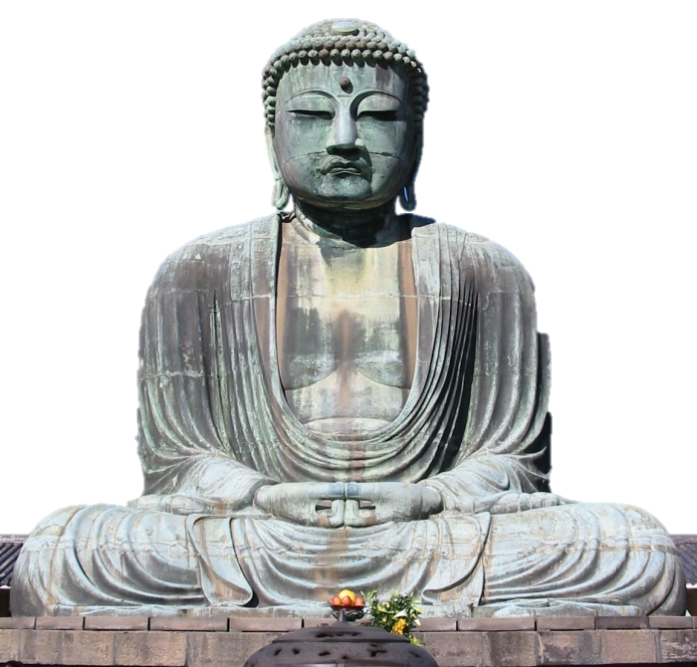

Slide 2
Appeal of Buddhism
Social heirarchy - Castes
  Did not recognize social distinctions based on caste
  message appealed strongly to lower castes
  Merchants prominent in ranks of early Buddhism

Slide 3
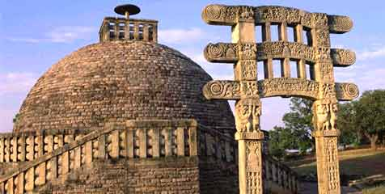
Appeal of Buddhism
Vernacular
  Early Buddhists favored local vernacular that reached larger numbers, instead of Sanskrit, literary language of Vedas
Stupas
  shrines housing relics of the Buddha and his first disciples
  Recognized holy sites that served as focal points of devotion

Slide 4
Appeal of Buddhism
Organization
  Buddhist movement was organized
  Gifts, grants, provided land, buildings, finances for monasteries
  Monks spent much time explaining dharma to lay audience
  Patronage of Mauryan dynasty added to appeal

Slide 5
Spread of Buddhism
Monks
  Spread, retained coherence
  Organized into monasteries that promoted the faith
Leaders – Asoka and later Kushan Emperors
  Growth spurred by conversion
  Encouraged missionaries (Sri Lanka, China, Korea, and Japan)
  ordered Buddhist relics enshrined in 84,000 stupas he had built all over his kingdom

Slide 6
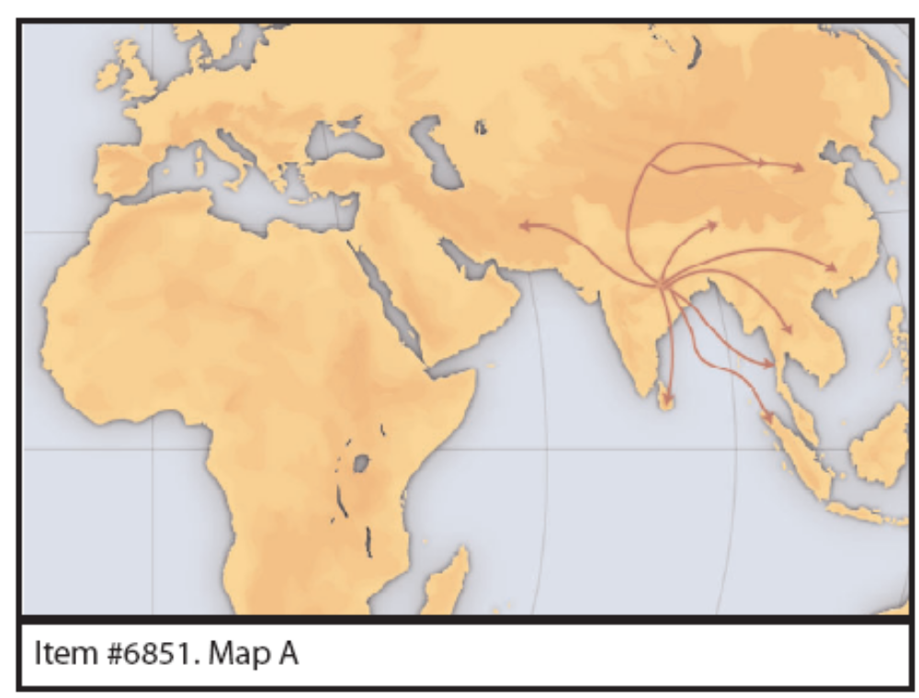
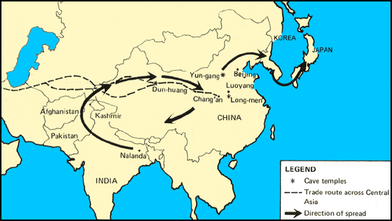
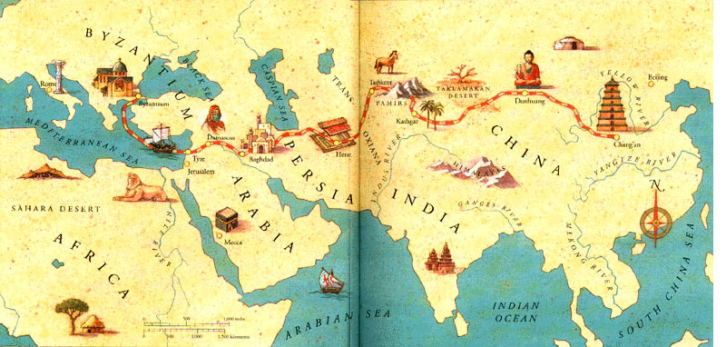

Slide 7
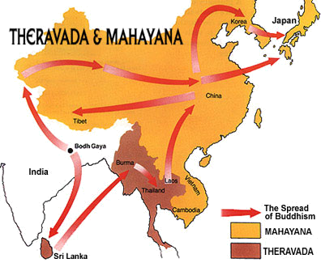
Spread of Buddhism
spread north and east w/in 200 years after death of Buddha
By 13th century Buddhism had virtually disappeared from India

Slide 8
Spread of Buddhism
What about India?
  Pockets of Buddhism remained in India, especially in the northeast
  Brahmin opposition was strong and aided by Gupta emperors
  Hinduism showed adaptability by emphasizing mystical side

Slide 9


Schools of Buddhism - Mahayana
The “Great Vehicle” (opened the road to many people)
100 C.E.
Northern Asia (China, Japan, etc.)
Lay Buddhism – Buddhism “for the masses”
Focus on compassion
Goal is to become a bodhisattva and assist others toward enlightenment

Slide 10


Schools of Buddhism - Theravada
The “Way of the Elders”
Oldest school of Buddhism - stricter
southern Asia (Sri Lanka, Burma, Thailand, etc.)
A “do-it-yourself” approach to enlightenment
Focus on wisdom and meditation
Goal is to become a Buddha

Slide 11
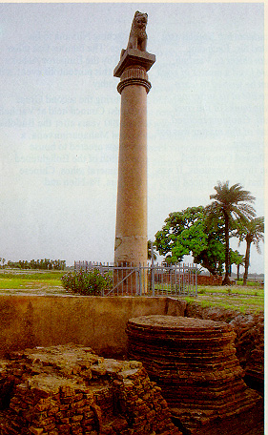
Mauryan Empire
Chandragupta Mauryan unified northern India
Asoka most famous emperor of Mauryan empire
Erected huge stone pillars inscribed with his policies-- some said that he would treat subjects fairly

Slide 12
Bodhisattvas
Held that some people could attain nirvana through their own meditation and still remain in world to teach others
Like Christian saints, they provided source of inspiration

Slide 13

Buddhist texts
Tripitaka (the Pali Cannon) – the “Three Baskets”:
  Vinaya (“discipline”) – rules for monastic life
  Sutta (“discourse”) – sermons of the Buddha
  Abhidhamma (metaphysical “teachings”)
Dhammapada – collected sayings of the Buddha
Other texts used by specific schools

